Slide 1


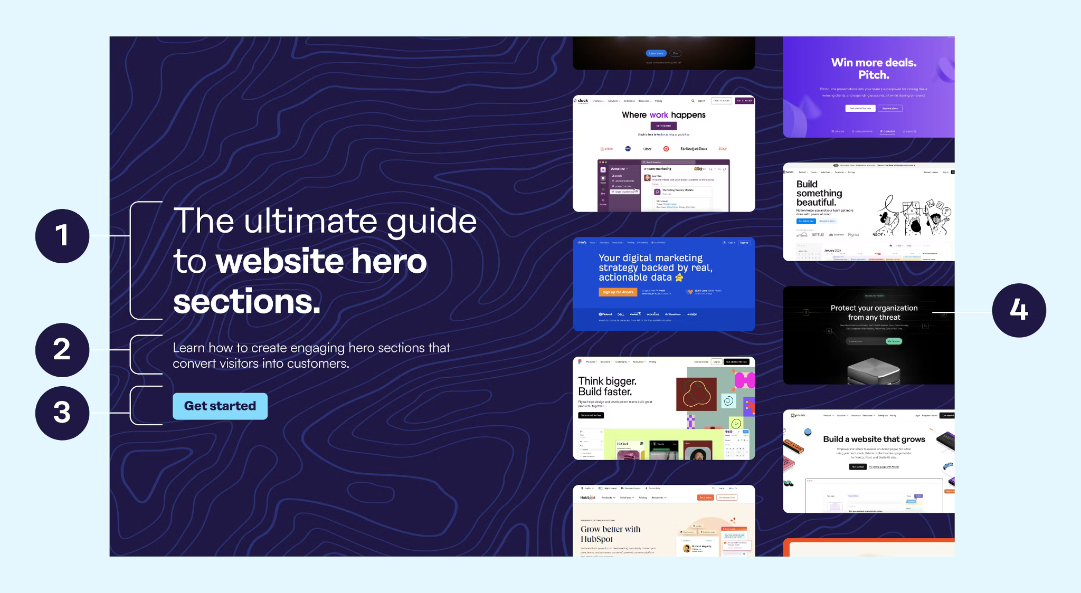

HIGH-IMPACT HERO SECTION & NAVIGATION
01 Visual Strategy: Adopt a "Brutalist" or "Bento" aesthetic. Raw elements, distinct blocks, deep black background (#000208).
02 Typography: Monospaced "coding" fonts (JetBrains Mono) for headers.
03 CTA: "Join the Club" above the fold in contrasting primary Blue (#3259E8).
• Import Fira Code or JetBrains Mono.
• Enable font-variant-ligatures: common-ligatures.
• Use CSS Grid for "Bento Box" layout.
• Ensure WCAG AA contrast (4.5:1).

Slide 2


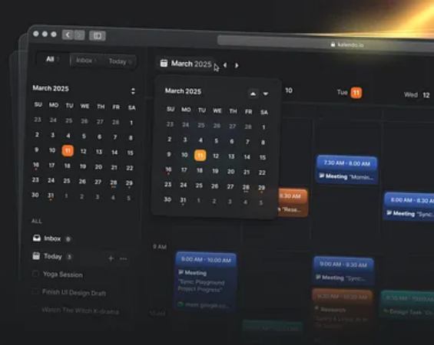

EVENTS DISCOVERY & MANAGEMENT
>
Display Logic: Split view for "Upcoming" vs. "Past". Past events dimmed for archival context.
>
Filtering: Tag-based filters (Workshops, Hackathons) and sorting options.
>
Calendar UI: Reactive calendar view for semester scheduling.
>
RSVP Action: Prominent "Save your Spot" buttons. Secondary CTAs after description blocks.
• State: Use Supabase (PostgreSQL) for real-time RSVP.
• Styling: Tailwind Grid for cards. opacity-60 for past events.
• Time: Handle timezones server-side.

Slide 3
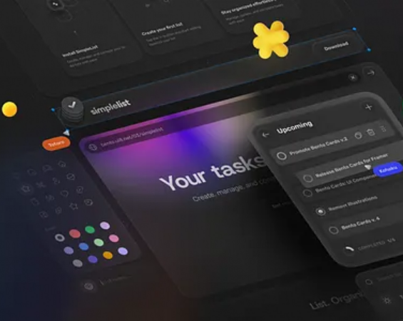
DYNAMIC PROJECT REPOSITORY
>
GitHub Integration: Auto-populate cards via API. Show Stars, Forks, "Last Updated".
>
Visuals: Pill-shaped "Tech Stack Badges" (React, Node.js).
>
Interaction: Direct links to "Live Demos" (Vercel) and Source Code.
>
Design: Distinct borders, flat colors, brutalist aesthetic.
• API: Use Next.js ISR to fetch GitHub data efficiently.
• CSS: Atomic utility classes (e.g., .rounded-full) for badges.
• Layout: Flex-wrap or Masonry for varied card heights.

Slide 4
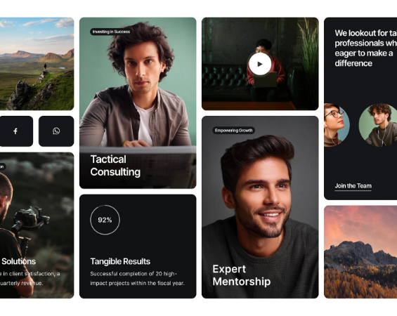

LEADERSHIP GRID & FUNNEL
>
Hierarchy Grid: Org chart (Execs > Leads > Members). Size denotes hierarchy.
>
Role Badges: Color-coded tags (Dev, Design, Marketing).
>
Recruitment Funnel: Segmented CTAs (New vs. Returning). "Apply for Leadership" prominent.
>
Bio Sections: Concise, with GitHub/LinkedIn links.
• Grid: CSS grid-template-areas for responsive structure.
• Images: Enforce aspect-square and object-cover.
• Hover: Subtle border color change to Accent #3259E8.

Slide 5



CORE ARCHITECTURE SPECS
FRAMEWORK
MOBILE FIRST
SEO & PERFORMANCE
DATABASE
Use Next.js over React.js. Superior FCP (First Contentful Paint) and TTI (Time to Interactive). Critical for varied network speeds.
Tailwind "Mobile First" approach. Design must adapt to mobile constraints before scaling up. Target layout stability.
Leverage Next.js SSR for 100% Lighthouse scores. Target FCP < 1.8s. Use component to prevent CLS.
Supabase (PostgreSQL) + RLS (Row Level Security). Safe user permission management and relational data models.

Slide 6
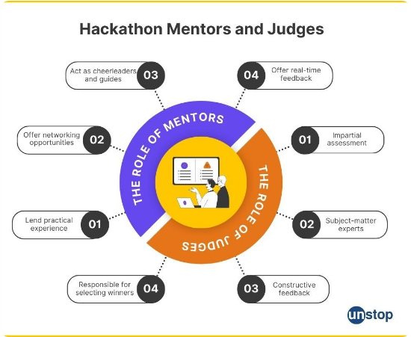
Judging Criteria
UI/UX Design Intuitive navigation, accessibility, and overall visual polish.
Functionality Completeness of features, bug-free execution, and real-world utility.
Technical Implementation Code quality, architectural complexity, and tech stack choices.
Presentation Clarity of the pitch, storytelling, and effectiveness of the live demo.

